Slide 1
Big Data Open Source Software and Projects
Introduction
I590 Data Science Curriculum
August 20 2014
Geoffrey Fox
gcf@indiana.edu
http://www.infomall.org
School of Informatics and Computing
Digital Science Center
Indiana University Bloomington

Slide 2
Introduction
Stress Programming Expertise
Python and Java

Slide 3
Introduction I
This course studies software used in many commercial activities to study Big Data. The backdrop for course is the ~120 software subsystems illustrated at http://hpc-abds.org/kaleidoscope/.
We will describe the software architecture represented by this collection which we term HPC-ABDS (High Performance Computing enhanced Apache Big Data Stack).
  A paper discussing this can be found at http://arxiv.org/abs/1403.1528
  http://grids.ucs.indiana.edu/ptliupages/publications/nist-hpc-abds.pdf
  http://grids.ucs.indiana.edu/ptliupages/publications/OgrePaperv9.pdf
and presentations at
  http://www.slideshare.net/Foxsden/microsoft-april302014 and
  http://www.slideshare.net/Foxsden/multifaceted-classification-of-big-data-uses-and-proposed-architecture-integrating-high-performance-computing-and-the-apache-stack.
Copies of this material may be found at http://www.infomall.org/I590ABDSSoftware/Resources/.

Slide 4
Introduction II
The course covers the following material
  The cloud computing architecture underlying ABDS and
  contrast of this with HPC.
  The software architecture with its different layers at http://hpc-abds.org/kaleidoscope/ covering broad functionality and rationale for each layer.
  We will give application examples
  Then we will go through selected software systems – about 10% of those in the Kaleidoscope which have been already deployed on FutureGrid systems using OpenStack and Chef recipes.
  Students will chose one other open source member of Kaleidoscope each and deploy as in d).
  The main activity of the course will be building a significant project using multiple HPC-ABDS subsystems combined with user code and data.
  Teams of up to 3 students can be formed with corresponding increase in scope in activities e), f)
Grading will be based on participation (10%), ABDS deployment (30%) and Project (60%). The class will interact with postings on a Google community group. The online section will also interact with Google Hangout or equivalent.
We will use FutureSystems (FutureGrid) facilities and cloud computing experience is helpful but not essential.
Good working experience with Java is required and Python will be used

Slide 5
Digital Data and Cloud backdrop

Slide 6
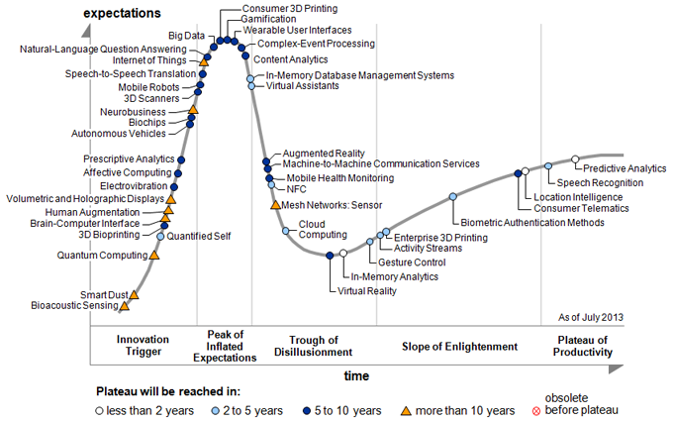
Gartner Emerging Technology Hype Cycle 2013

Slide 7
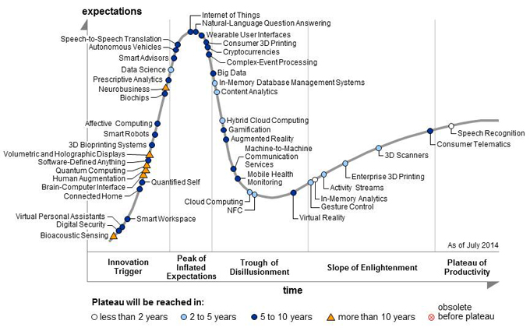
Gartner Emerging Technology Hype Cycle 2014

Slide 8
Six Business Era Models in the Digital Business Development Path
As set out on the Gartner road map to
digital business, there are six progressive
business era models that enterprises can identify with today and to which they can aspire in the future.
Last 3 are in Emerging Technologies Hype cycle
Stage 1: Analog
Stage 2: Web
Stage 3: E-Business
Stage 4: Digital Marketing
Stage 5: Digital Business
Stage 6: Autonomous
http://www.gartner.com/newsroom/id/2819918?_ga=1.51071721.1904172021.1401730474

Slide 9
Digital Business Development
Stage 4: Digital Marketing
The Digital Marketing stage sees the emergence
of the Nexus of Forces (mobile, social, cloud and
information).
  Enterprises in this stage focus on new and more sophisticated ways to reach consumers, who are more willing to participate in marketing efforts to gain greater social connection, or product and service value.
  Buyers of products and services have more brand influence than previously, and they see their mobile devices and social networks as preferred gateways.
  Enterprises at this stage grapple with tapping into buyer influence to grow their business.
Digital Marketing tech includes: Software-Defined Anything; Volumetric and Holographic Displays; Neurobusiness; Data Science; Prescriptive Analytics; Complex Event Processing; Big Data; In-Memory DBMS; Content Analytics; Hybrid Cloud Computing; Gamification; Augmented Reality; Cloud Computing; NFC; Virtual Reality; Gesture Control; In-Memory Analytics; Activity Streams; Speech Recognition.

Slide 10
Digital Business Development
Stage 5: Digital Business
Digital Business is the first post-nexus stage on the road map
and focuses on the convergence of people, business and things.
  The Internet of Things and the concept of blurring the physical and virtual worlds are strong concepts in this stage.
  Physical assets become digitalized and become equal actors in the business value chain alongside already-digital entities, such as systems and apps.
  3D printing takes the digitalization of physical items further and provides opportunities for disruptive change in the supply chain and manufacturing.
  The ability to digitalize attributes of people (such as the health vital signs) is also part of this stage.
  Even currency (which is often thought of as digital already) can be transformed (for example, cryptocurrencies).
  Enterprises seeking to go past the Nexus of Forces technologies (stage 4) to become a digital business should look to these additional technologies:
Digital Business tech includes: Bioacoustic Sensing; Digital Security; Smart Workspace; Connected Home; 3D Bioprinting Systems; Affective Computing; Speech-to-Speech Translation; Internet of Things; Cryptocurrencies; Wearable User Interfaces; Consumer 3D Printing; Machine-to-Machine Communication Services; Mobile Health Monitoring; Enterprise 3D Printing; 3D Scanners; Consumer Telematics.

Slide 11
Digital Business Development
Stage 6: Autonomous
Autonomous represents the final
post-nexus stage.
  This stage is defined by an enterprise's ability
  to leverage technologies that provide humanlike
  or human-replacing capabilities.
  Using autonomous vehicles to move people or products or using cognitive systems to write texts or answer customer questions are all examples that mark the Autonomous stage.
  Enterprises seeking to reach this stage to gain competitiveness should consider these technologies on the Hype Cycle
Autonomous stage tech include: Virtual Personal Assistants; Human Augmentation; Brain-Computer Interface; Quantum Computing; Smart Robots; Biochips; Smart Advisors; Autonomous Vehicles; Natural-Language Question Answering.

Slide 12
REAL WORLD BIGData

Slide 13
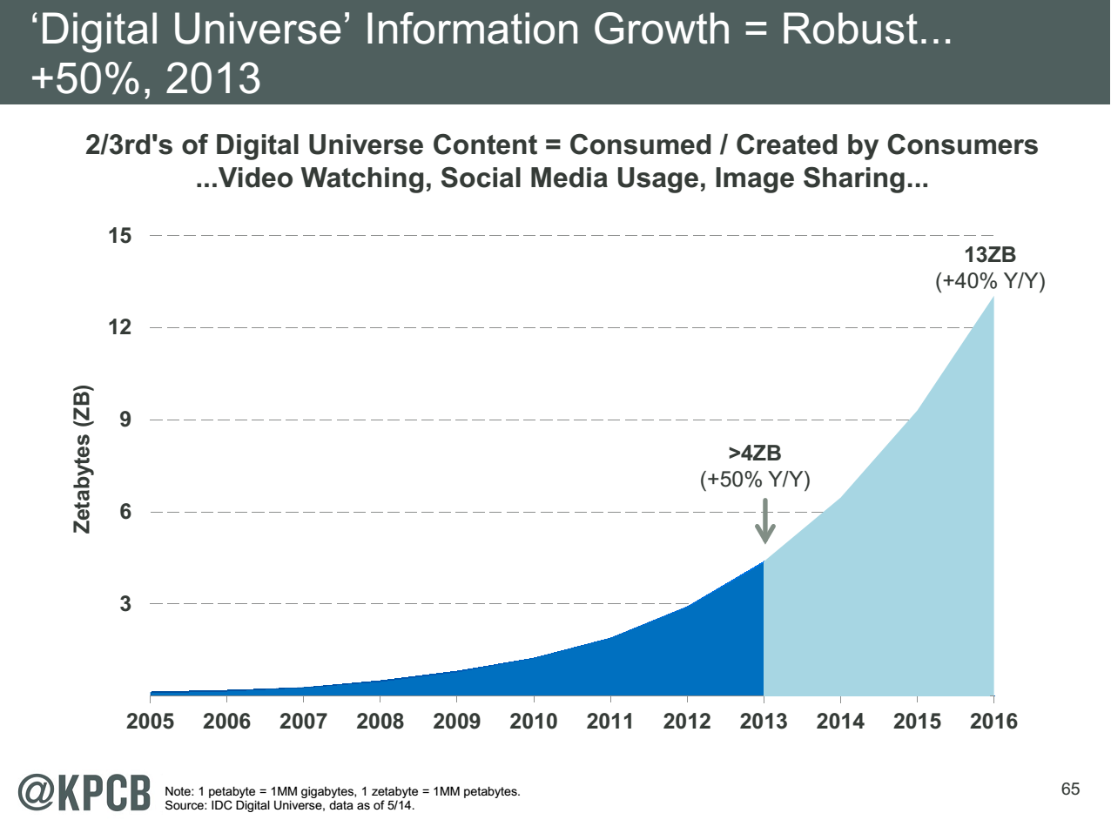
My Research focus is Science Big Data but note
Note largest science ~100 petabytes = 0.000025 total
Science should take notice of commodity
Converse not clearly true?
Note 7 ZB (7. 10²¹) is about a
terabyte (10¹²) for each person in world
http://www.kpcb.com/internet-trends

Slide 14
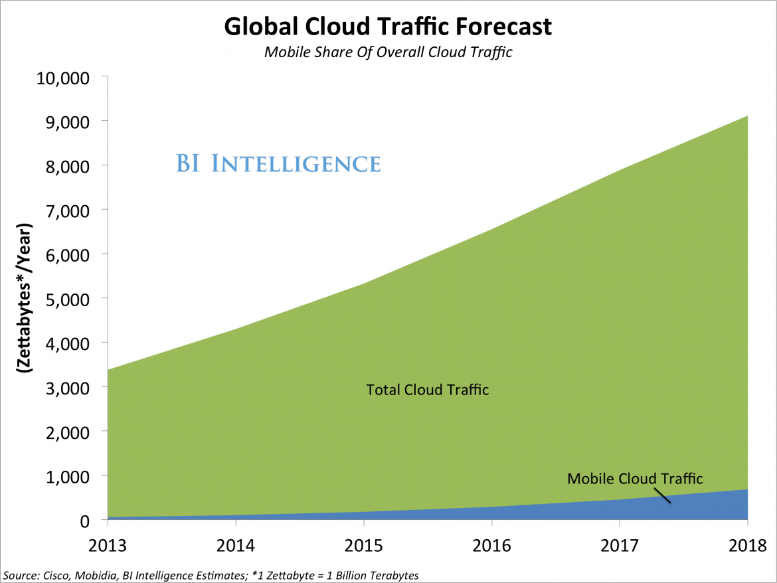

Slide 15
http://www.kpcb.com/internet-trends

Slide 16
http://www.kpcb.com/internet-trends

Slide 17
http://www.kpcb.com/internet-trends

Slide 18
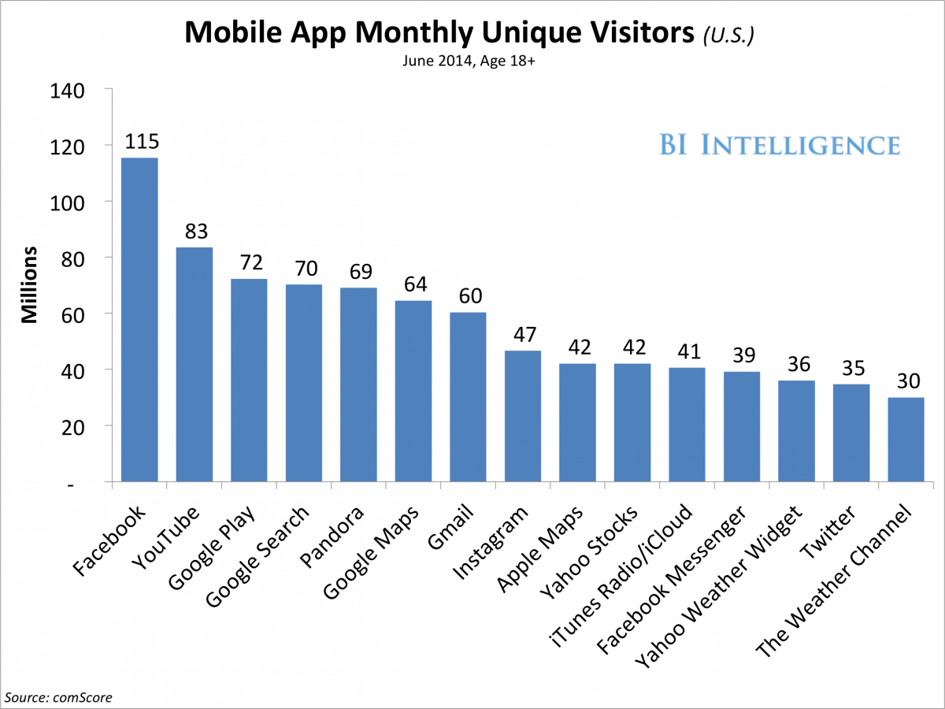

Slide 19
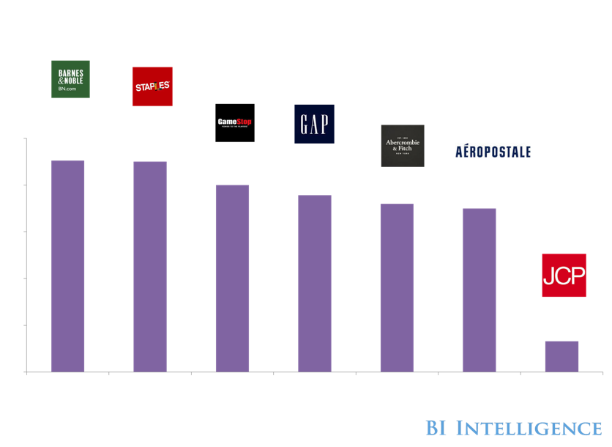
Hundreds Of Retail Stores Are Closing
No more malls?

Slide 20















Where Are Shoppers Going?

Slide 21
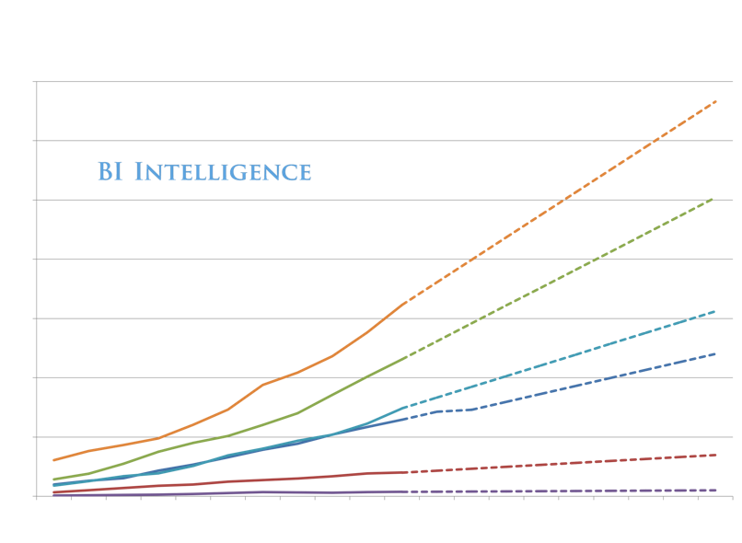
Online!
We Are Here

Slide 22
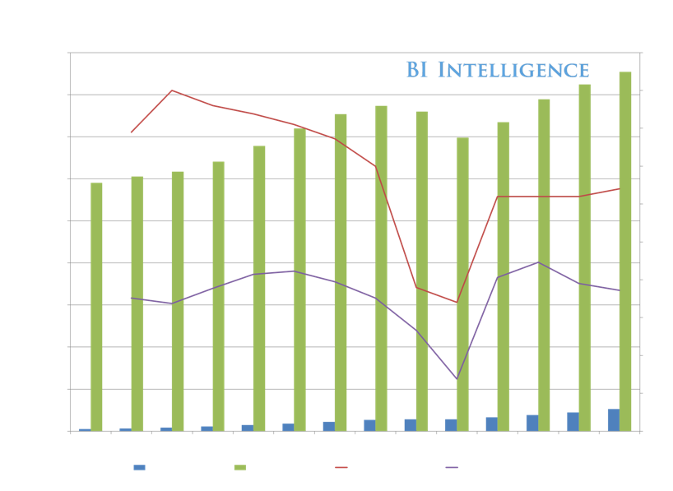
E-Commerce Is Driving Nearly All Retail Growth In US

Slide 23
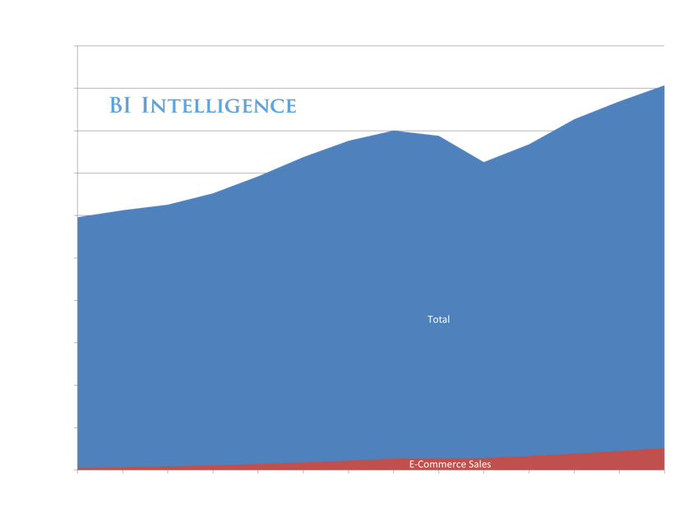
1 In 20 Retail Dollars Are Already Online

Slide 24
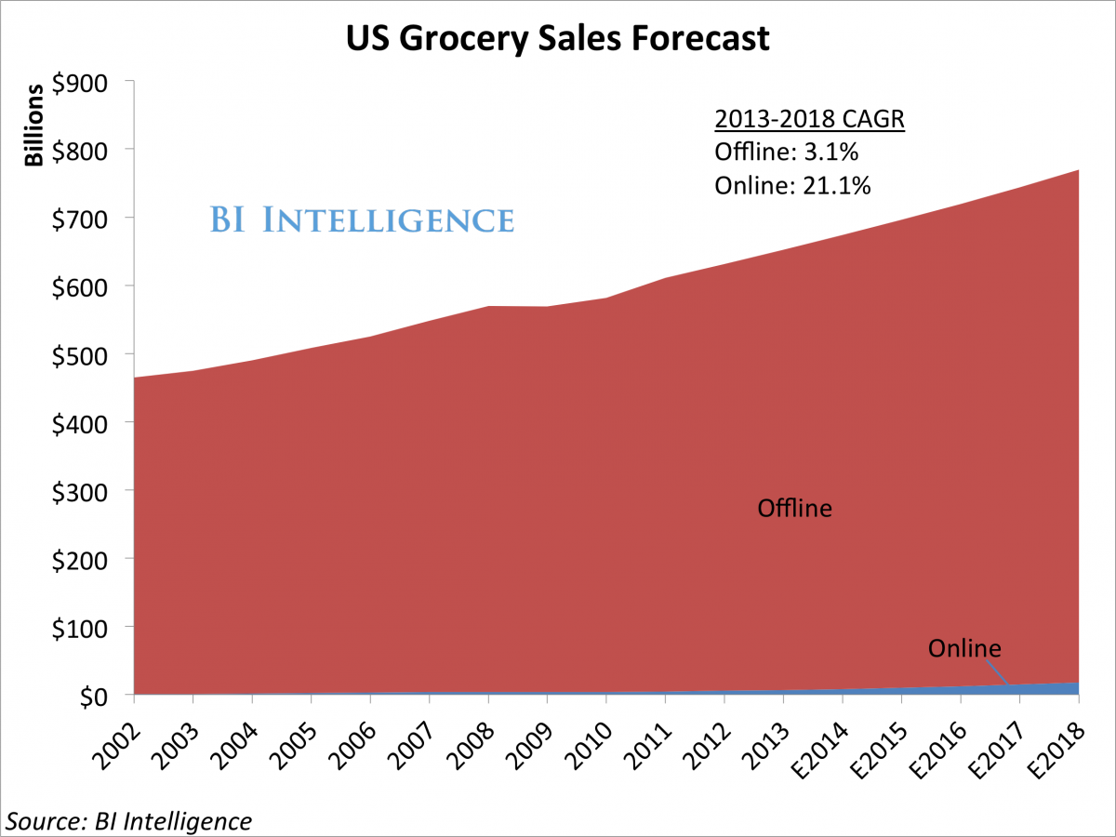
Even online groceries taking off

Slide 25
BASIC Trends and JOBS

Slide 26
Note that translates NOW into smaller devices
In PAST translated into faster devices of same form factor
http://www.kpcb.com/internet-trends

Slide 27
http://www.kpcb.com/internet-trends

Slide 28
http://www.kpcb.com/internet-trends

Slide 29
http://www.kpcb.com/internet-trends

Slide 30
http://www.kpcb.com/internet-trends

Slide 31
http://www.kpcb.com/internet-trends

Slide 32
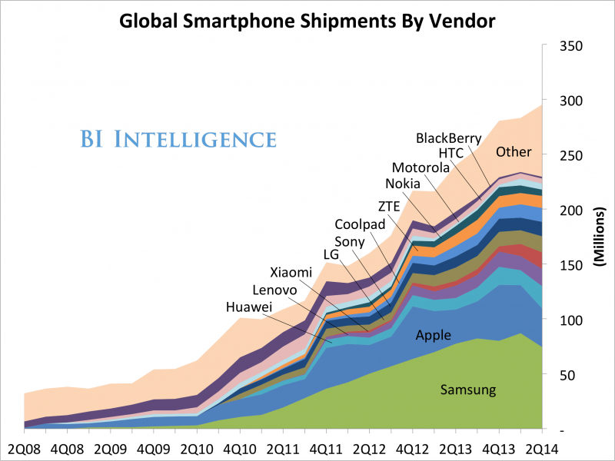

Slide 33
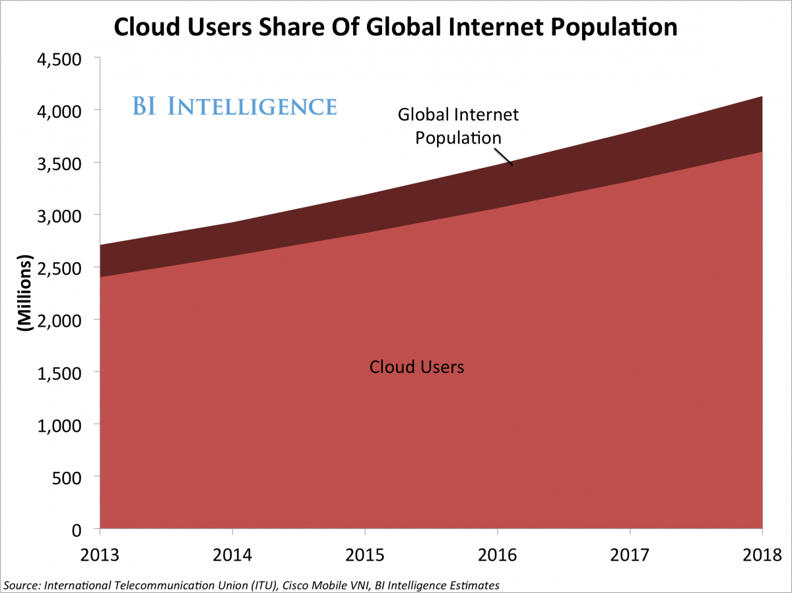

Slide 34
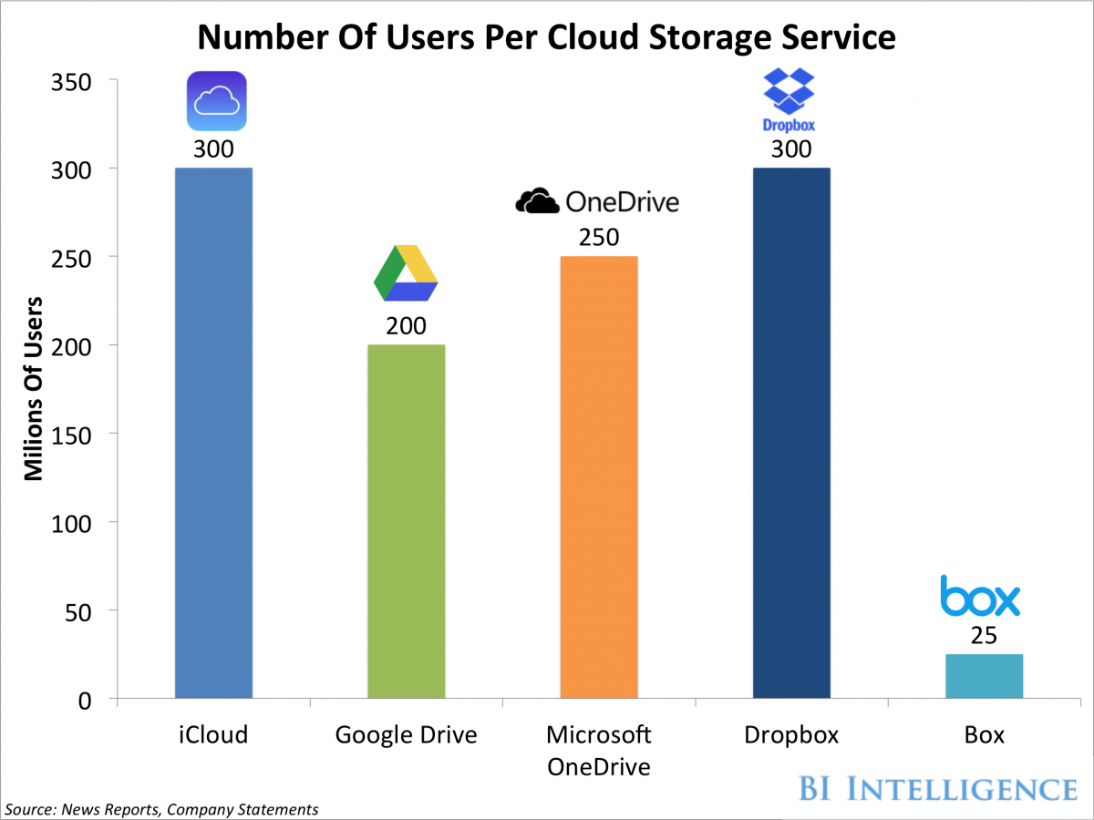

Slide 35
Jobs

Slide 36
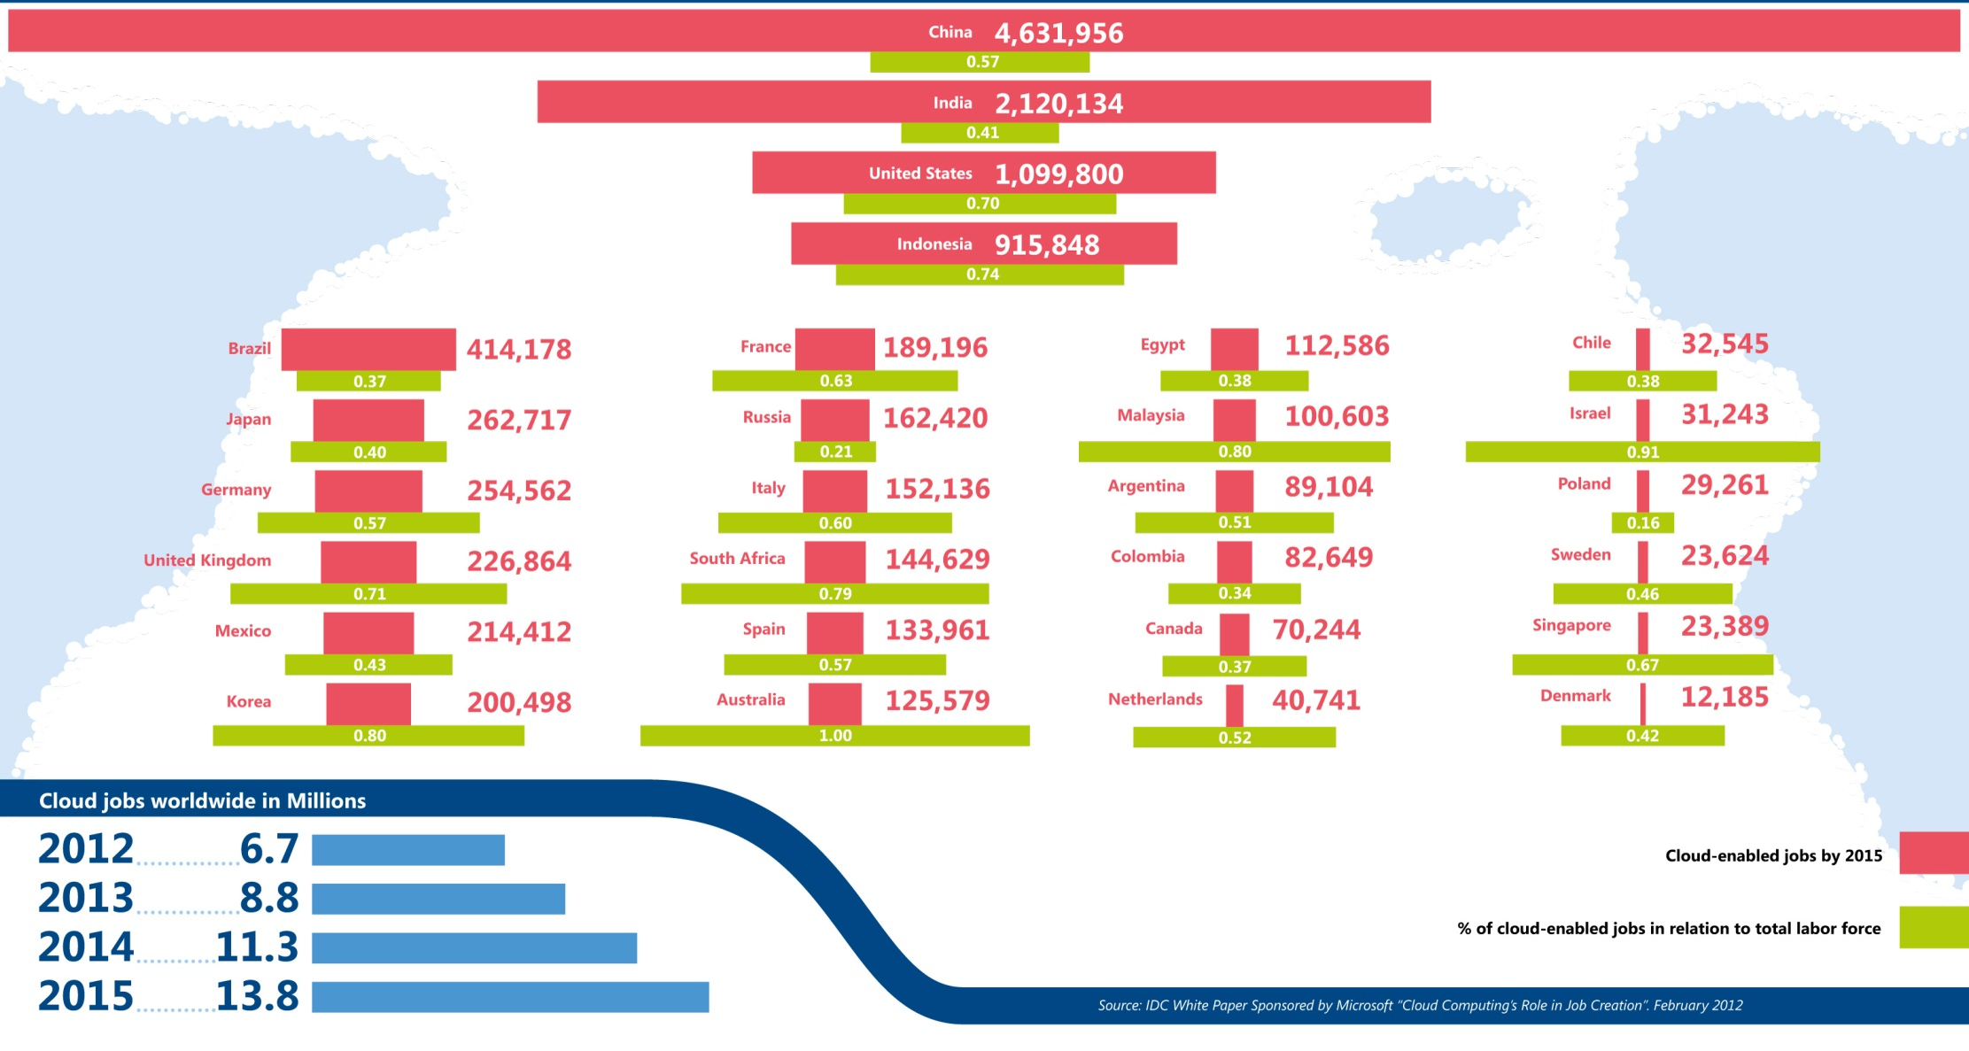
Jobs v. Countries
http://www.microsoft.com/en-us/news/features/2012/mar12/03-05CloudComputingJobs.aspx

Slide 37
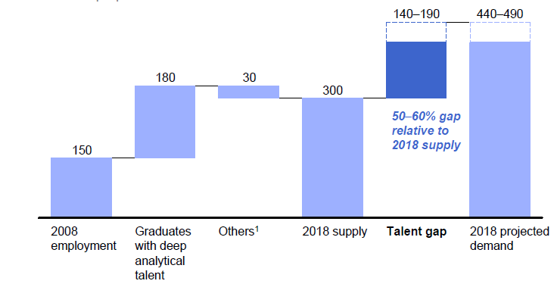
McKinsey Institute on Big Data Jobs
There will be a shortage of talent necessary for organizations to take advantage of big data. By 2018, the United States alone could face a shortage of 140,000 to 190,000 people with deep analytical skills as well as 1.5 million managers and analysts with the know-how to use the analysis of big data to make effective decisions.
At IU, Informatics aimed at 1.5 million jobs. Computer Science covers the 140,000 to 190,000
http://www.mckinsey.com/mgi/publications/big_data/index.asp.

